Slide 1
Software Engineering
Lesson – UML Activity Diagrams

Slide 2
Lesson Content
What is an Activity Diagram
General Notation
Components of an Activity Diagram
Guidelines

Slide 3
What is Activity Diagram?
The object-oriented equivalent of flow charts and data-flow diagrams (DFDs) from structured development
Activity diagrams used to explore the logic of:
A complex method
A complex business rule
A single use case
Several use cases
A business process
Software processes
Modeling complex functions can prevent problems later when you write the code by revealing all the requirements explicitly in the diagram. Models make most, if not all, of your assumptions visible and consequently easier to test, review and correct.

Slide 4
Components
4
Initial node
Actions
Flows / Edges
Activity final
Fork + Join
Decision + Merge
Guards

Slide 5
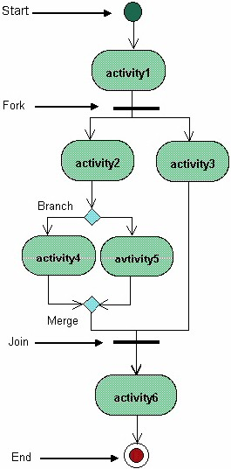
Activity Diagram Components
An Activity, also known as an activity state, on a UML Activity diagram typically represents the invocation of an operation, a step in a business process, or an entire business process
A Guard is a condition that must be true in order to traverse a transition. Guards Should Not Overlap
A Decision Point (Branch). Each Transition Leaving a Decision Point Must Have a Guard They help to describe the decision point. Guards on Decision Points Must Form a Complete Set
A Swimlane is a way to group activities performed by the same actor on an activity diagram or to group activities in a single thread

Slide 6
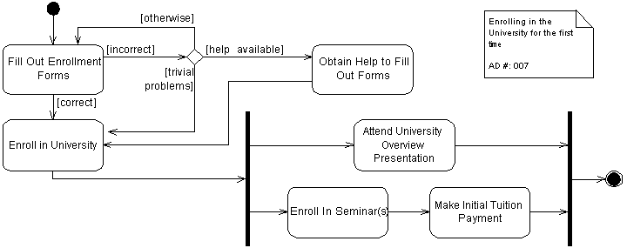
Parallel Activities
It is possible to show that activities can occur in parallel
A transition may fork into two or more parallel activities. The fork and the subsequent join of the threads coming out of the fork appear in the diagram as solid bars.
A Fork Should Have a Corresponding Join
Forks Have One Entry Transition
Joins Have One Exit Transition

Slide 7
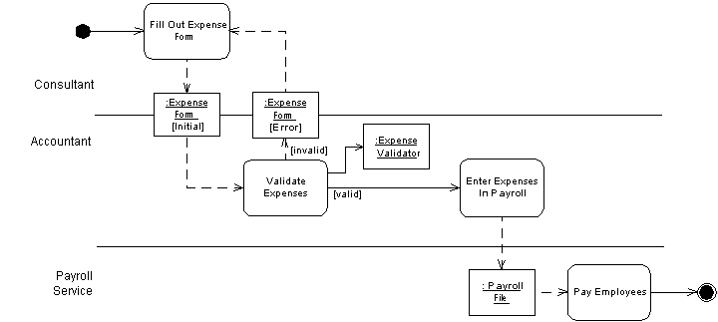
Swimlane
A swimlane is a way to group activities performed by the same actor on an activity diagram or to group activities in a single thread
Used when you want to show who does what,
an activity diagram becomes divided into into partitions, which show which actions one employee or organization unit carries out.

Slide 8
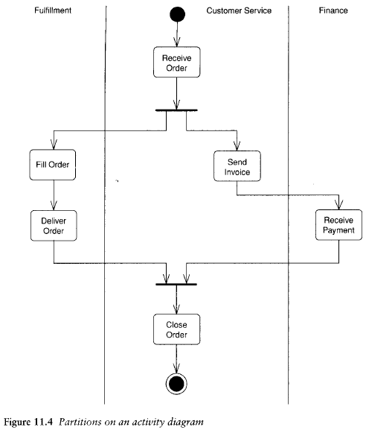
8
Swimlanes example

Slide 9
Reference List
[1] Venters W, 2008, Software engineering: theory and application: chapter 7, pp 56-58, LSE, University of London
[2] Fowler M, 2003, UML Distilled. A Brief Guide to Standard Object Modelling Language, Addison Wesley, 3rd edition

Slide 10

End of Lesson
Any questions?

